Slide 1


Theoretical Elaboration on the Hidden Markov Model used in some Selected Applications
Xinhao Luo
Shanghai Jiao Tong University
Code: https://github.com/uaenalxh/HMM

Slide 2
Content
1
Abstract
2
Model
3
Applications
4
Prediction Problem
5
Brute Force
6
Dynamic Programming

Slide 3
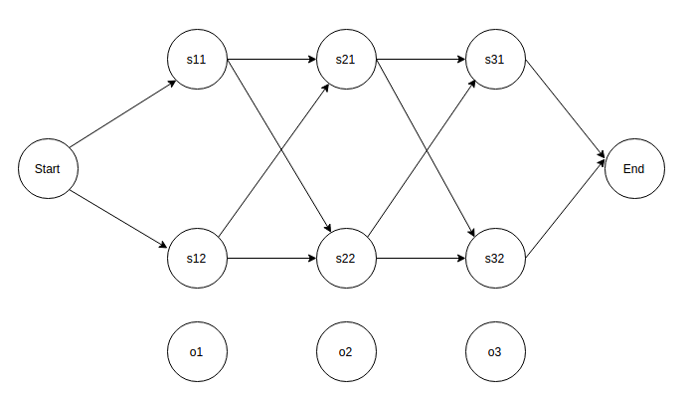






Abstract
Hidden Markov Model(HMM) is a type of Markov chain where the states cannot be observed directly, but can be inferred from a sequence of observation vectors.
Since the 1980s, HMM has been successfully applied in machine recognition due to its abundant mathematical structures.
$$s_{t−1}$$
$$s_{t}$$
$$s_{t+1}$$
$$o_{t−1}$$
$$o_{t}$$
$$o_{t+1}$$
HMM Model
HMM Model used in Word Segmentation

Slide 4
Abstract
I attempt to carefully study the theoretical basis of this type of statistical model HMM and show applications in some selected problems. (Mainly in Prediction problem).
Probability computation
Learning problem
Prediction problem

Slide 5
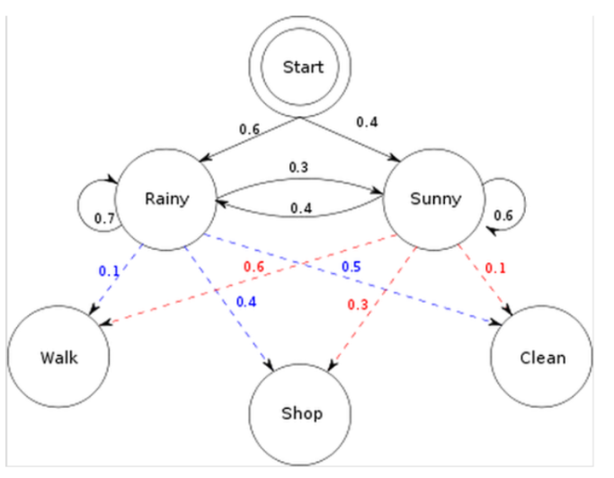






Introduction
state sequence
$$s_{t−1}$$
$$s_{t}$$
$$s_{t+1}$$
Hidden Markov chain, generating an observed sequence by state sequence.
Hidden Markov Model(HMM), a probabilistic model for time series, describes the process of generating an unobservable sequence of random states by a hidden Markov chain.
observed sequence
$$o_{t−1}$$
$$o_{t}$$
$$o_{t+1}$$

Slide 6



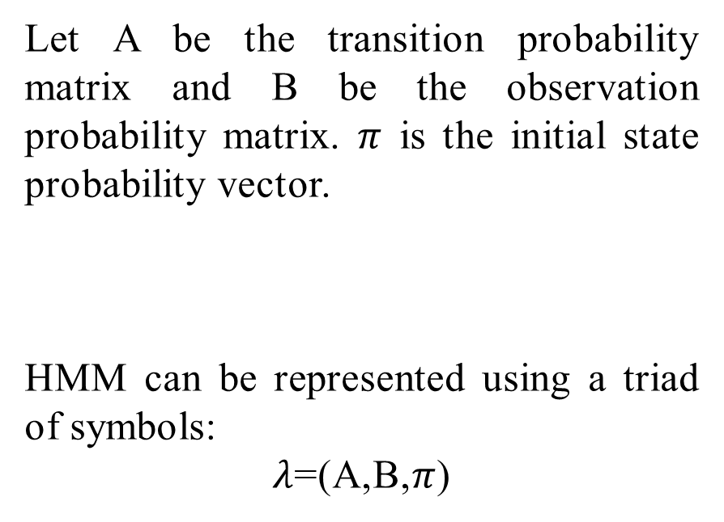





Model
Let A be the transition probability matrix and B be the observation probability matrix. $π$ is the initial state probability vector.
HMM can be represented using a triad of symbols:
$λ$=(A,B,$π$)
$$A=P=(s_{t}|s_{t−1})$$
$$s_{t−1}$$
$$s_{t}$$
$$s_{t+1}$$
$$o_{t−1}$$
$$o_{t}$$
$$o_{t+1}$$
$$B=P=(o_{t}|s_{t})$$

Slide 7
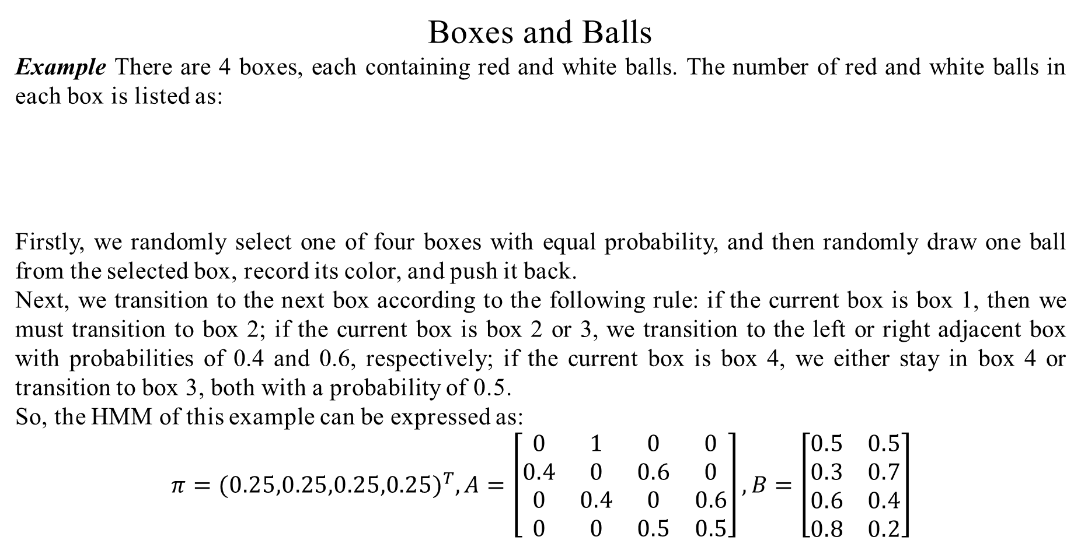
Model
Boxes and Balls
Example There are 4 boxes, each containing red and white balls. The number of red and white balls in each box is listed as:
Firstly, we randomly select one of four boxes with equal probability, and then randomly draw one ball from the selected box, record its color, and push it back.
Next, we transition to the next box according to the following rule: if the current box is box 1, then we must transition to box 2; if the current box is box 2 or 3, we transition to the left or right adjacent box with probabilities of 0.4 and 0.6, respectively; if the current box is box 4, we either stay in box 4 or transition to box 3, both with a probability of 0.5.
So, the HMM of this example can be expressed as:
$$π={(0.25,0.25,0.25,0.25)}^{T},A=\left[\begin{matrix}0 & 1 & 0 & 0 \\ 0.4 & 0 & 0.6 & 0 \\ 0 & 0.4 & 0 & 0.6 \\ 0 & 0 & 0.5 & 0.5\end{matrix}\right],B=\left[\begin{matrix}0.5 & 0.5 \\ 0.3 & 0.7 \\ 0.6 & 0.4 \\ 0.8 & 0.2\end{matrix}\right]$$
box | 1 | 2 | 3 | 4
red | 5 | 3 | 6 | 8
white | 5 | 7 | 4 | 2

Slide 8
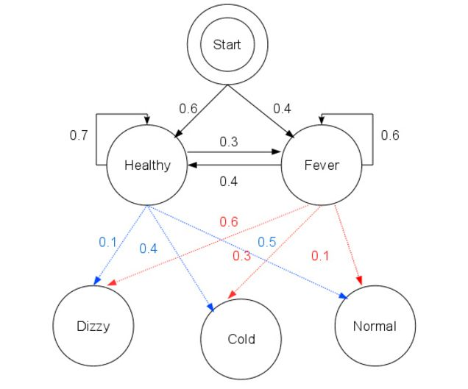
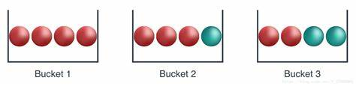
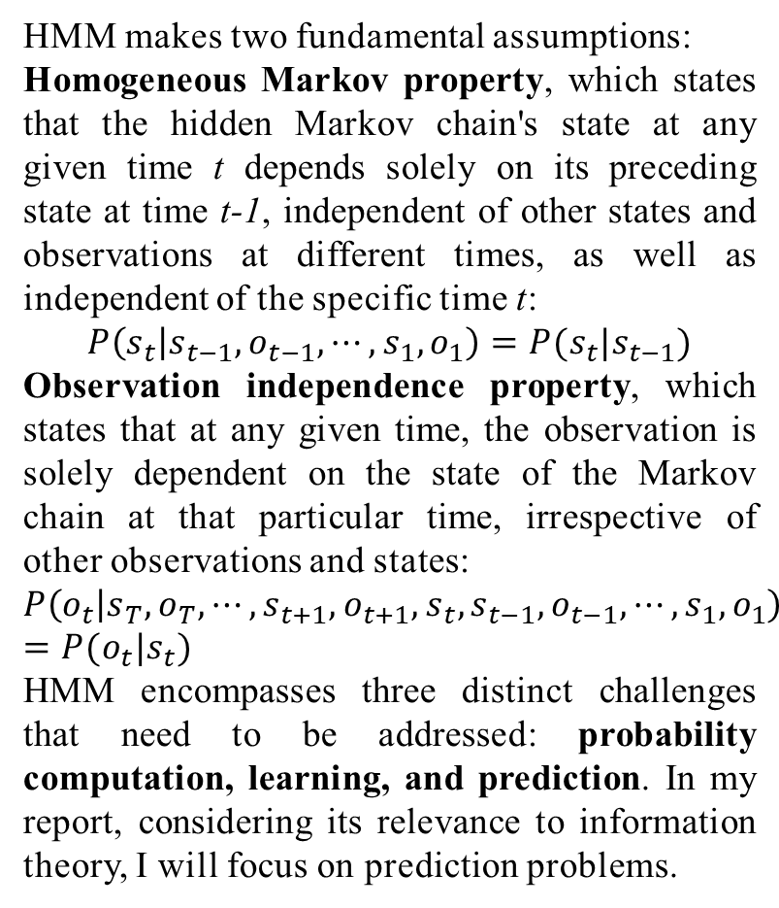
Applications
HMM makes two fundamental assumptions:
Homogeneous Markov property, which states that the hidden Markov chain's state at any given time t depends solely on its preceding state at time t-1, independent of other states and observations at different times, as well as independent of the specific time t:
$$P\left(s_{t} | s_{t−1},o_{t−1},⋯,s_{1},o_{1}\right)=P(s_{t}|s_{t−1})$$
Observation independence property, which states that at any given time, the observation is solely dependent on the state of the Markov chain at that particular time, irrespective of other observations and states:
$$P\left(o_{t} | s_{T},o_{T},⋯,s_{t+1},o_{t+1},s_{t},s_{t−1},o_{t−1},⋯,s_{1},o_{1}\right)=P(o_{t}|s_{t})$$
HMM encompasses three distinct challenges that need to be addressed: probability computation, learning, and prediction. In my report, considering its relevance to information theory, I will focus on prediction problems.
Probability Computation Problem
Learning problem(k-means)
Prediction Problem(Boxes and balls)

Slide 9
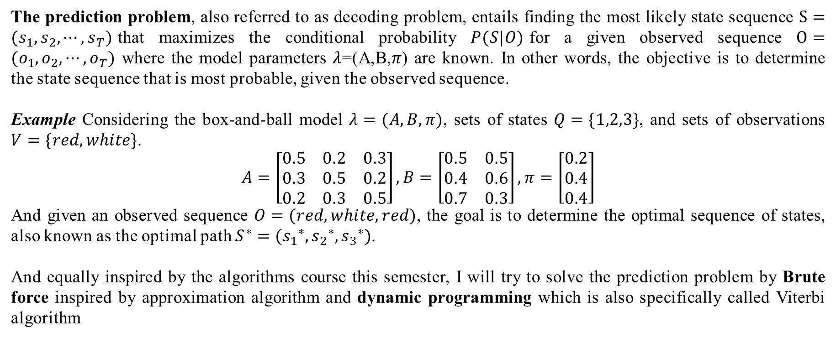
Prediction Problem
The prediction problem, also referred to as decoding problem, entails finding the most likely state sequence $S=(s_{1},s_{2},⋯,s_{T})$that maximizes the conditional probability $P(S|O)$for a given observed sequence $O=(o_{1},o_{2},⋯,o_{T})$ where the model parameters $λ$=(A,B,$π$) are known. In other words, the objective is to determine the state sequence that is most probable, given the observed sequence.
Example Considering the box-and-ball model $λ=(A,B,π)$, sets of states $Q=\{1,2,3\}$, and sets of observations $V=\{red,white\}$.
$$A=\left[\begin{matrix}0.5 & 0.2 & 0.3 \\ 0.3 & 0.5 & 0.2 \\ 0.2 & 0.3 & 0.5\end{matrix}\right], B=\left[\begin{matrix}0.5 & 0.5 \\ 0.4 & 0.6 \\ 0.7 & 0.3\end{matrix}\right],π=\left[\begin{matrix}0.2 \\ 0.4 \\ 0.4\end{matrix}\right]$$
And given an observed sequence $O=(red, white, red)$, the goal is to determine the optimal sequence of states, also known as the optimal path $S^{∗}=({s_{1}}^{∗},{s_{2}}^{∗},{s_{3}}^{∗})$.
And equally inspired by the algorithms course this semester, I will try to solve the prediction problem by Brute force inspired by approximation algorithm and dynamic programming which is also specifically called Viterbi algorithm

Slide 10
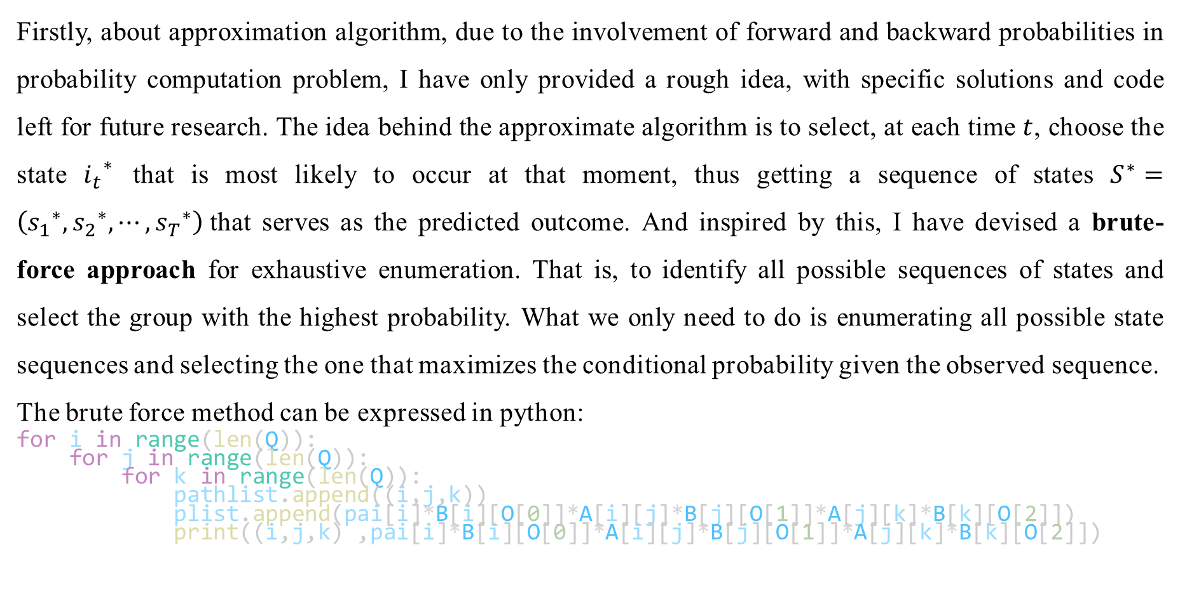
Brute Force
Firstly, about approximation algorithm, due to the involvement of forward and backward probabilities in probability computation problem, I have only provided a rough idea, with specific solutions and code left for future research. The idea behind the approximate algorithm is to select, at each time $t$, choose the state ${i_{t}}^{∗}$ that is most likely to occur at that moment, thus getting a sequence of states $S^{∗}=\left({s_{1}}^{∗},{s_{2}}^{∗},⋯,{s_{T}}^{∗}\right)$that serves as the predicted outcome. And inspired by this, I have devised a brute-force approach for exhaustive enumeration. That is, to identify all possible sequences of states and select the group with the highest probability. What we only need to do is enumerating all possible state sequences and selecting the one that maximizes the conditional probability given the observed sequence.
The brute force method can be expressed in python:
for i in range(len(Q)):
for j in range(len(Q)):
for k in range(len(Q)):
pathlist.append((i,j,k))
plist.append(pai[i]*B[i][O[0]]*A[i][j]*B[j][O[1]]*A[j][k]*B[k][O[2]])
print((i,j,k) ,pai[i]*B[i][O[0]]*A[i][j]*B[j][O[1]]*A[j][k]*B[k][O[2]])

Slide 11
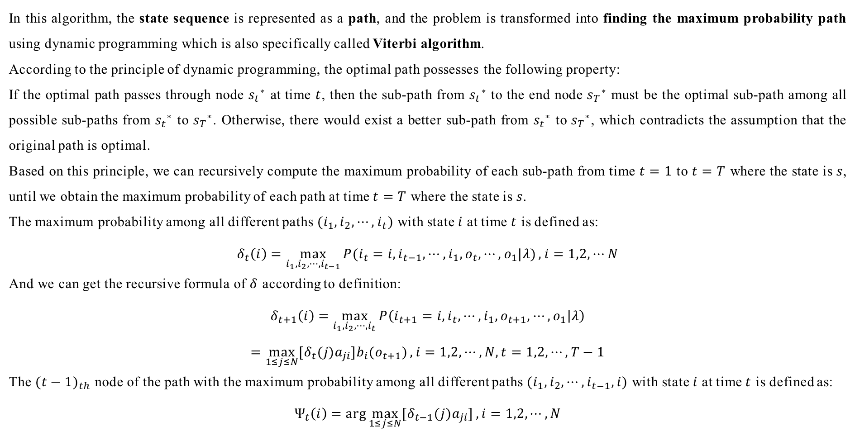
Dynamic Programming
In this algorithm, the state sequence is represented as a path, and the problem is transformed into finding the maximum probability path using dynamic programming which is also specifically called Viterbi algorithm.
According to the principle of dynamic programming, the optimal path possesses the following property:
If the optimal path passes through node ${s_{t}}^{∗}$ at time $t$, then the sub-path from ${s_{t}}^{∗}$ to the end node ${s_{T}}^{∗}$ must be the optimal sub-path among all possible sub-paths from ${s_{t}}^{∗}$ to ${s_{T}}^{∗}$. Otherwise, there would exist a better sub-path from ${s_{t}}^{∗}$ to ${s_{T}}^{∗}$, which contradicts the assumption that the original path is optimal.
Based on this principle, we can recursively compute the maximum probability of each sub-path from time $t=1$ to $t=T$ where the state is $s$, until we obtain the maximum probability of each path at time $t=T$ where the state is $s$.
The maximum probability among all different paths $(i_{1},i_{2},⋯,i_{t})$ with state $i$ at time $t$ is defined as:
$$δ_{t}\left(i\right)=\max_{i_{1},i_{2},⋯,i_{t−1}}{P(i_{t}=i,i_{t−1},⋯,i_{1},o_{t},⋯,o_{1}|λ)}, i=1,2,⋯N$$
And we can get the recursive formula of $δ$ according to definition:
$$δ_{t+1}\left(i\right)=\max_{i_{1},i_{2},⋯,i_{t}}{P\left(i_{t+1}=i,i_{t},⋯,i_{1},o_{t+1},⋯,o_{1} | λ\right)}$$
$$=\max_{1≤j≤N}{[δ_{t}(j)a_{ji}]b_{i}(o_{t+1})}, i=1,2,⋯,N, t=1,2,⋯,T−1$$
The ${(t−1)}_{th}$ node of the path with the maximum probability among all different paths $(i_{1},i_{2},⋯,i_{t−1},i)$ with state $i$ at time $t$ is defined as:
$$Ψ_{t}\left(i\right)=\arg{\max_{1≤j≤N}{[δ_{t−1}(j)a_{ji}]}}, i=1,2,⋯,N$$

Slide 12
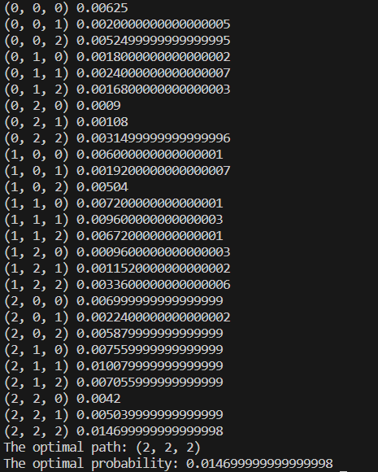
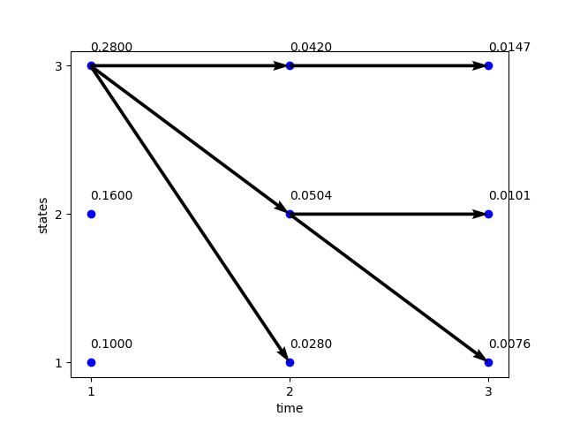
Experiment
For the box-and-ball model problem:
Brute Force Dynamic Programming
So, the optimal state path is S=(box3,box3,box3)

Slide 13
Future Work
HMM exhibits certain limitations:
Markov property (finite history): In some special scenario, such as natural language processing (NLP), many words in text data exhibit long dependencies.
Homogeneity: The state transition matrix at different positions in a sequence may vary, indicating that positional information affects prediction results.
Observational independence: There is a correlation between observations in many tasks.
Directed graph: Only the preceding state is relevant, and the subsequent state is irrelevant. In many tasks, contextual information is essential.
Label bias: If state A can transition to N states, and state B can transition to M states, if N << M, the predicted sequence is more likely to choose state A because A has a higher transition probability such as its requirement for discrete time points and independent observations. In reality, state values exhibit long-range dependencies and observations may possess certain non-independent cross-features.
Looking forward to encountering a broader range of relevant knowledge in future studies!

Slide 14
Reference
[1] LEONARD E. Baum, J. A. EAGON (1966) An inequality with applications to statistical estimation for probabilistic functions of Markov processes and to a model for ecology.
[2] RABINER L, JUANG B (1986). An introduction to hidden Markov Models[J]. IEEE ASSP Magazine.
[3] Hang Li. (2021) Machine Learning: An Algorithmic Perspective. Tsinghua University Press.
[4] Zhihua Zhou. (2015) Machine Learning. Tsinghua University Press.

Slide 15
Code
My code can be available at:
https://github.com/uaenalxh/HMM

Slide 16

Thanks
Many thanks to Prof. Cheng and the teaching assistants for your help in my study of information theory. Although I did not perform well in the final exam due to health and other reasons, I still learned a lot of fundamental knowledge, and I am grateful once again for your assistance.

